Slide 1

Marketing Campaign
Destiny 2: Beyond Light

Slide 2
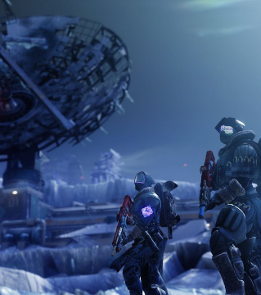
Destiny 2: Beyond Light
Campaign
Overview
Sci-Fi Adventure Video Game
November 10 Release
Bungie, Inc. – Creator of Halo
Xbox, PlayStation, PC
Launch Title for Xbox Series X
Digital Marketing Campaign
June 9-November 10

Slide 3
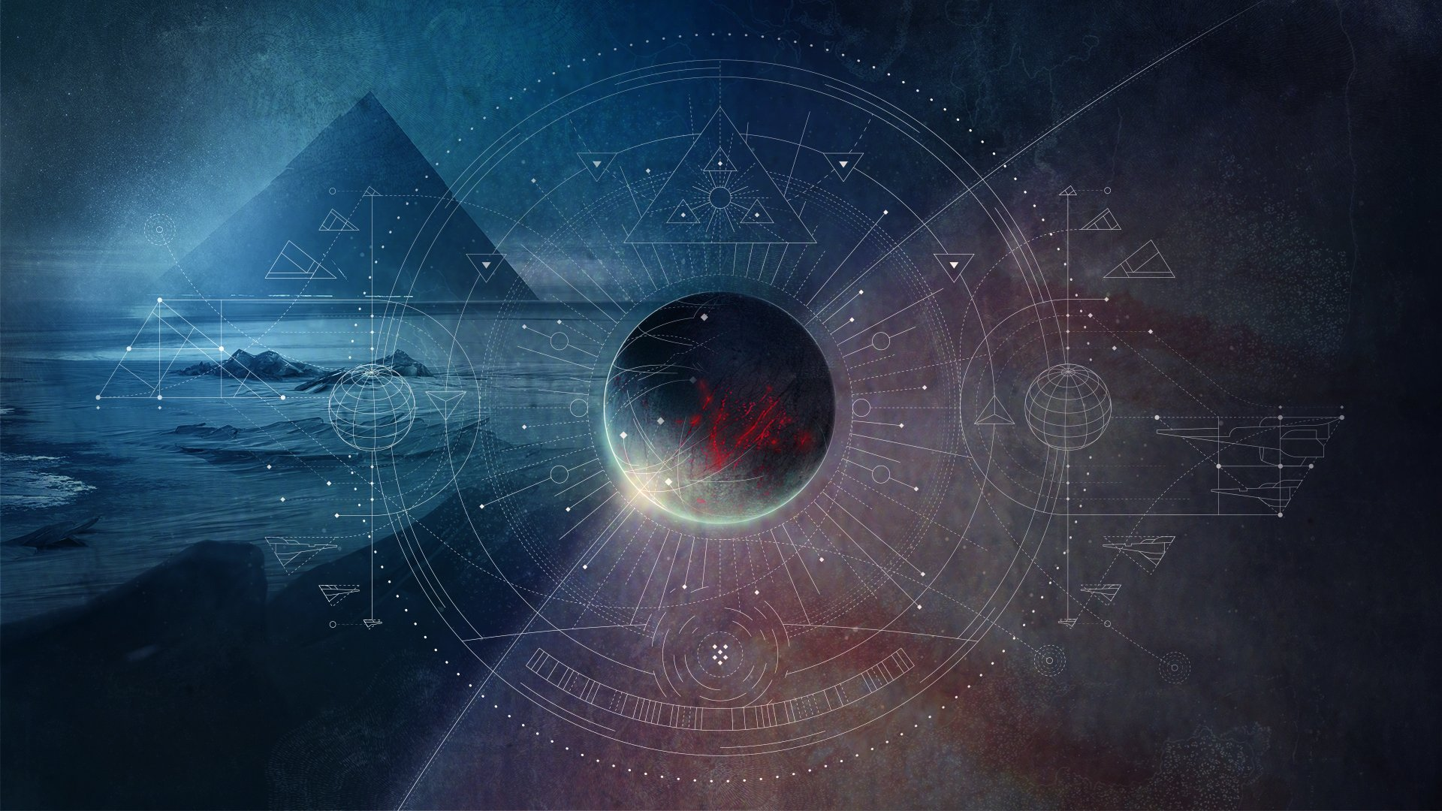
Destiny 2
Game Overview
#2
#2
#10
40M+
First Person Shooter (The NPD Group)
2017 Best-Seller (Gamespot)
All-Time Xbox One (The NPD Group)
Total Players (Steamspy, Gamestat)

Slide 4
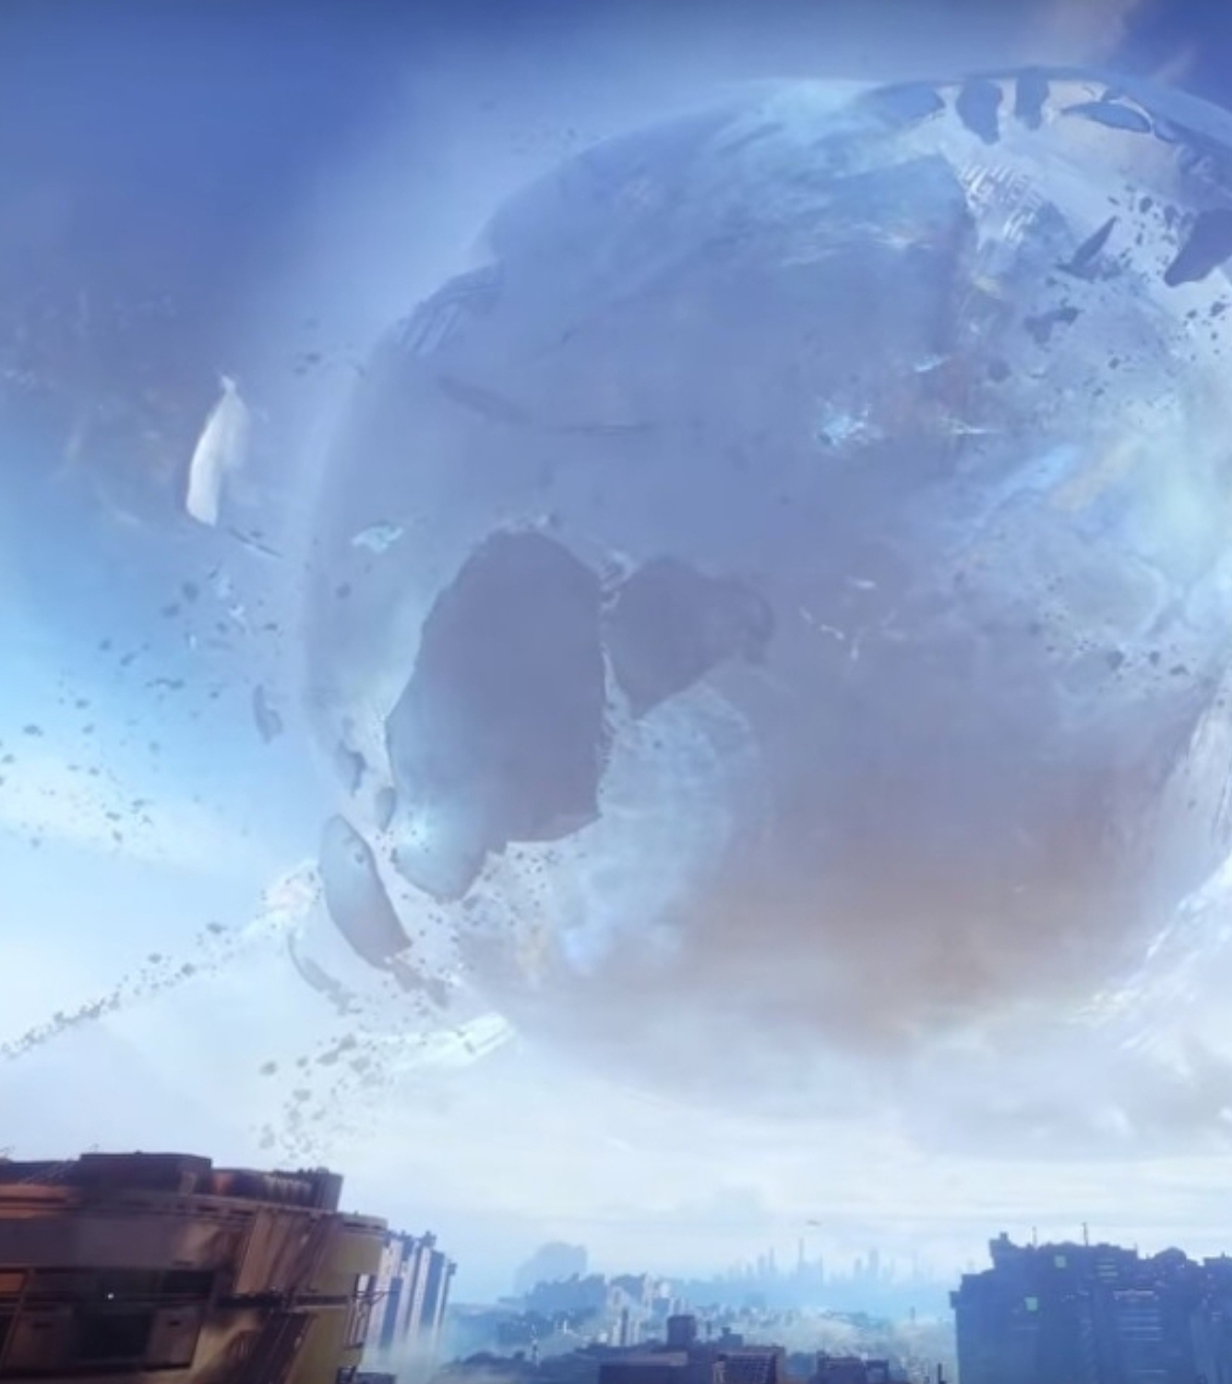
Website
Multimedia
Trailers, infographics, images, soundtracks, comic books
Emails & newsletters
Content marketing
Blogposts, journalism, creator-driven content, video sharing
PPC/display ads
Promotional pricing
Social media
In-game incentives
Campaign
Elements

Slide 5

Community Engagement
Outbound Strong usage of standard avenues for outbound digital marketing: Google Ads, YouTube, Facebook, Xbox…
Inbound …matched with an inbound strategy rooted in: linkbuilding, content creation, & social media content
Player Base The approach focuses on mobilizing the most active members of the player base…
Organic Content ...to generate a strong degree of natural linking, social media hype, and other forms of organic interest.
Philosophy: Marketing is a bridge
“between the worlds we make and the one you’re in”

Slide 6
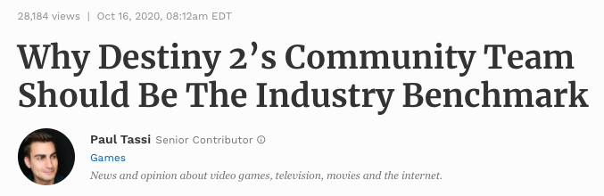
Community Managers
Source: Forbes Magazine

Slide 7
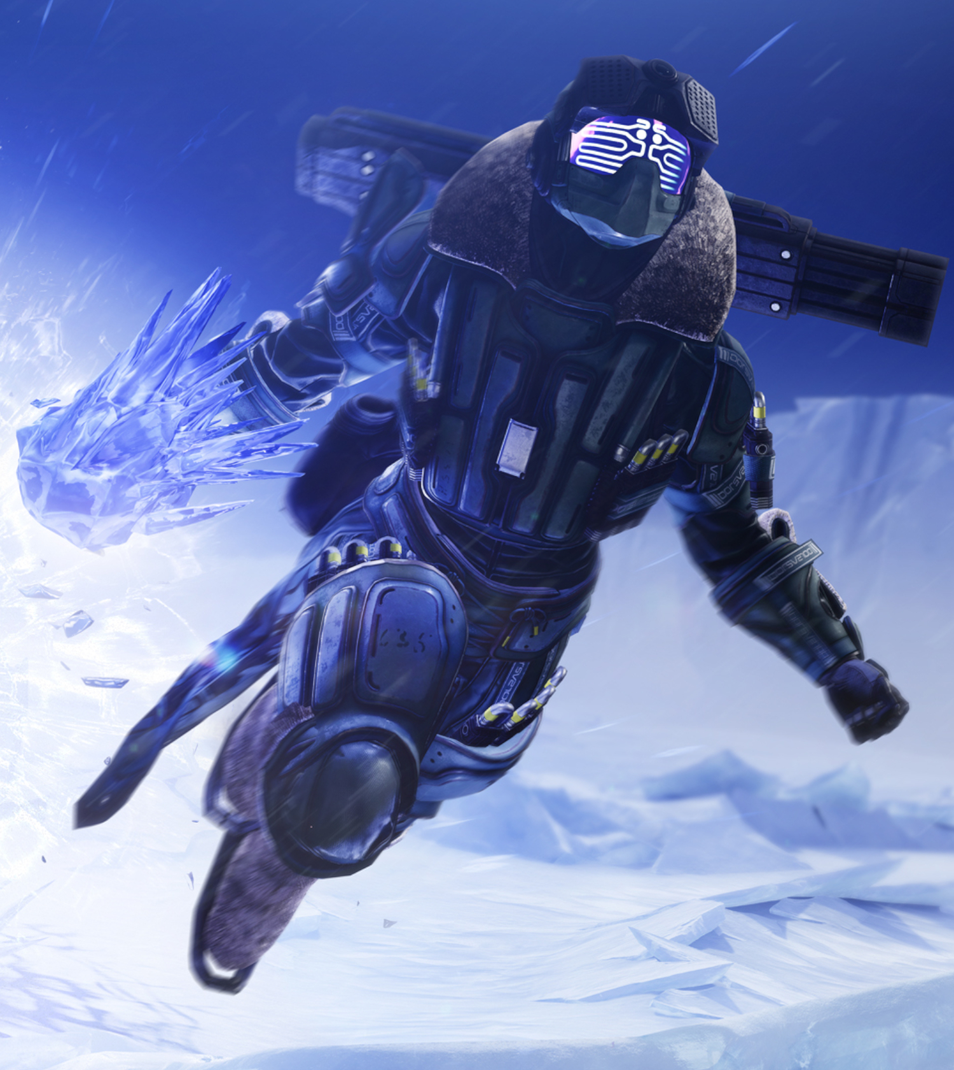
Team of community managers
Marketing through engagement
Online PR
E.g. responding to negative and positive reviews on Reddit
Content Marketing
E.g. blogposts, newsletters, interviews, video streams
Social Media
E.g. Twitter, Reddit
Community
Managers

Slide 8
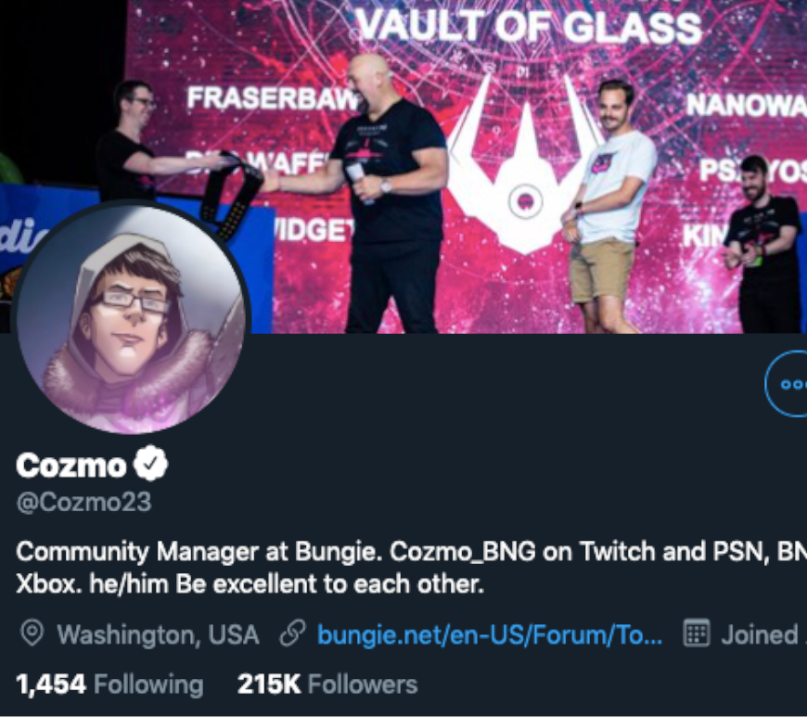
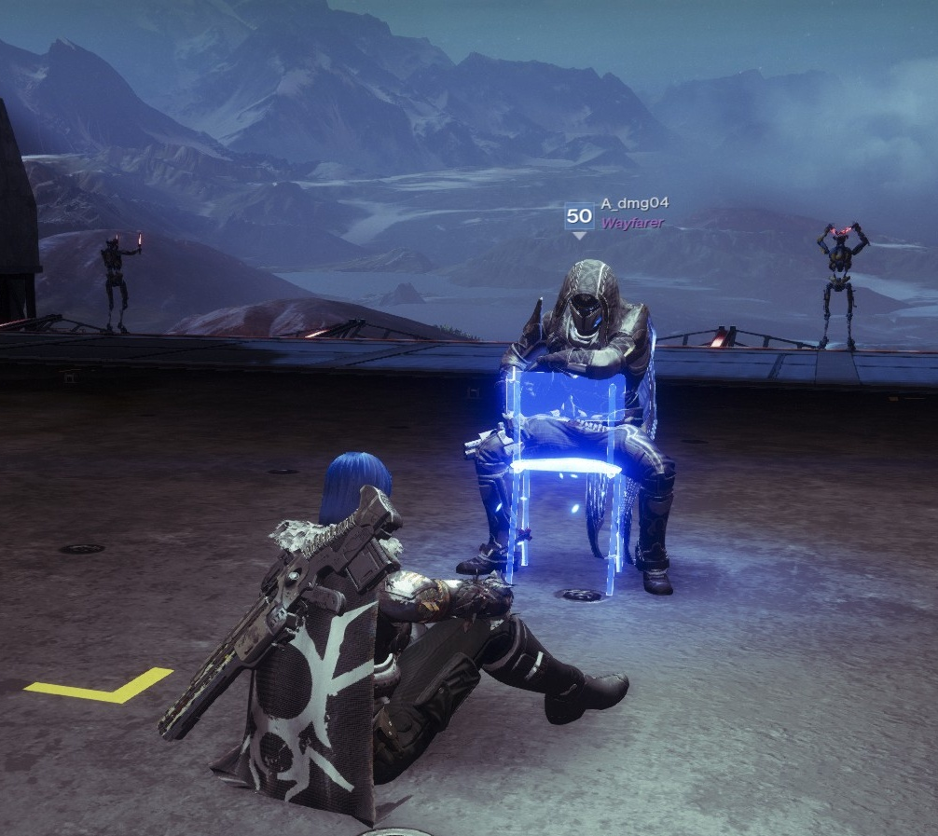
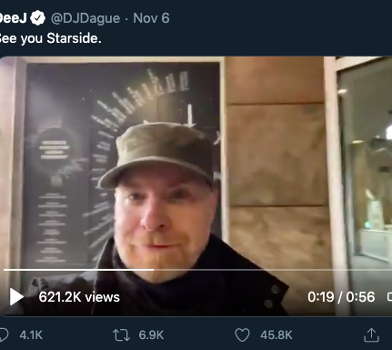
Community Managers
They are from the Community
They are Destiny Fans…
…And Part of the Player Base
Chris Shannon (Cozmo23) is a founder of the r/destinythegame Reddit page. He was hired because of his profile within the player base.
Community managers are marketing staff, but they also participate in the game and contribute to the broader community.
Destiny fans embrace them as members of the community; they respect their viewpoints and engage with their content.

Slide 9
The End
Jarek Paul Ervin
jarekpaulervin@gmail.com

Slide 10
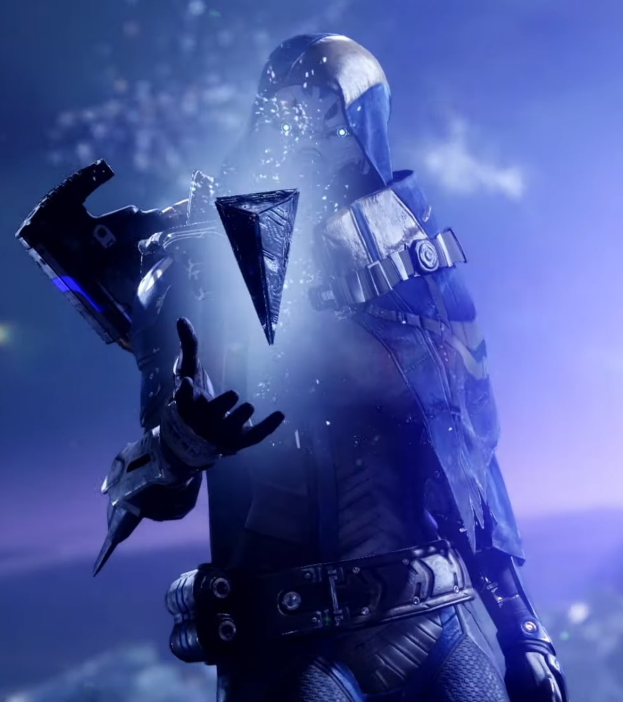
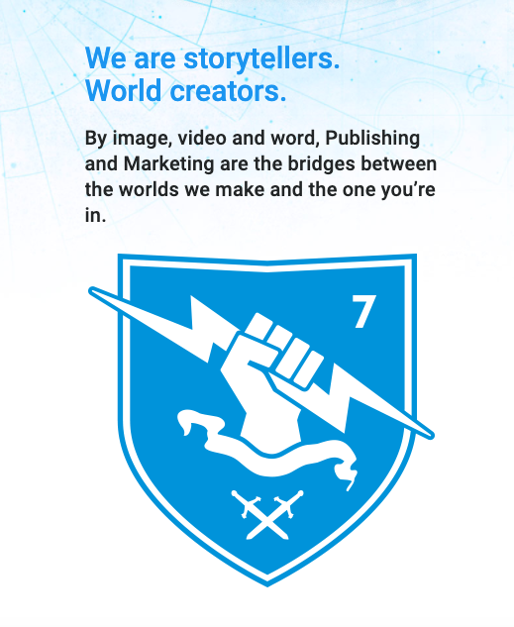
Marketing Philosophy

Slide 11
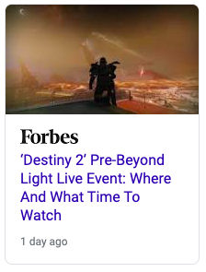
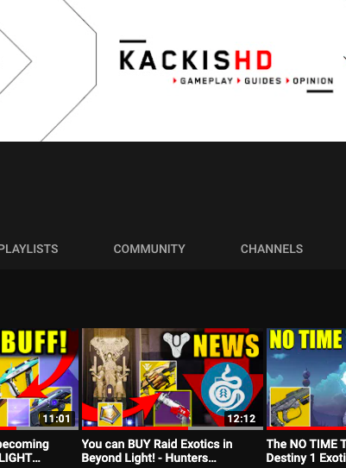
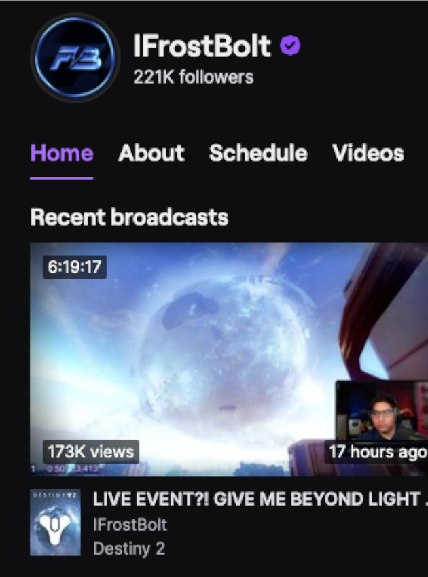
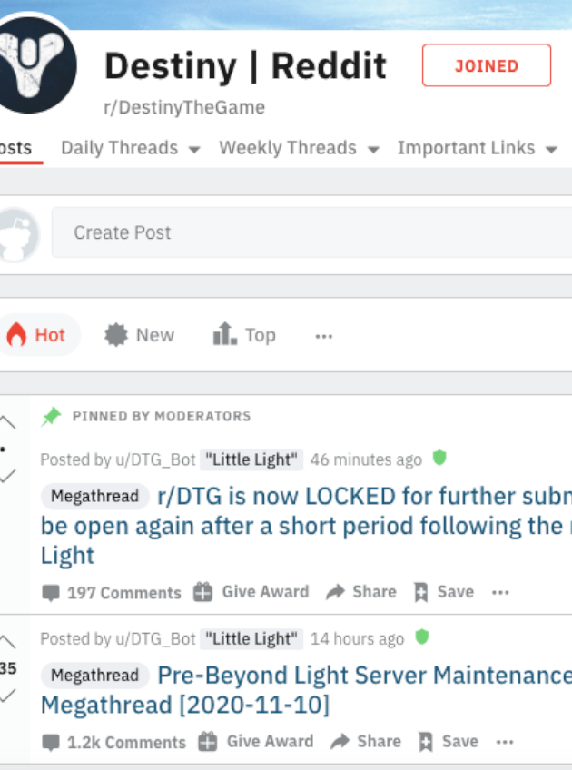
Off Page SEO
Journalists
YouTube Creators
Twitch Streamers
Social Media

Slide 12
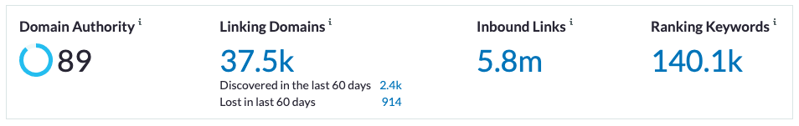
Linkbuilding Overview
Source: MOZ Link Research

Slide 13
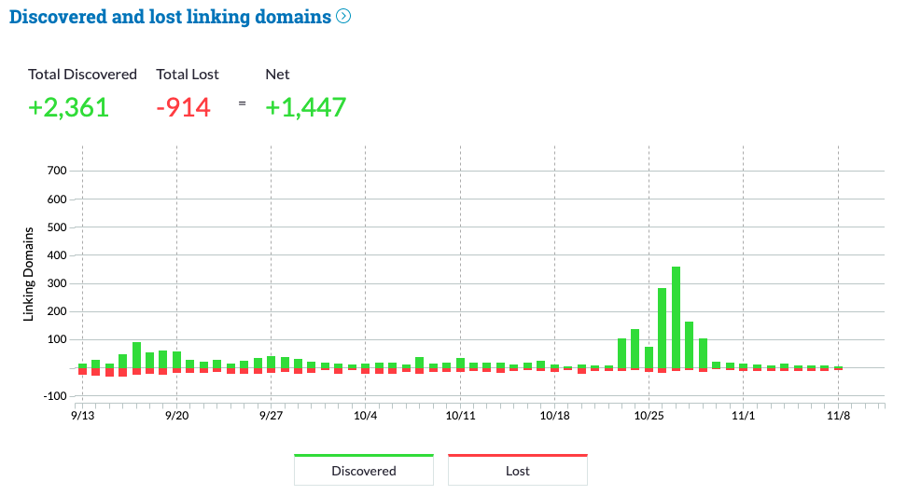
Link Performance
Source: MOZ Link Research

Slide 14
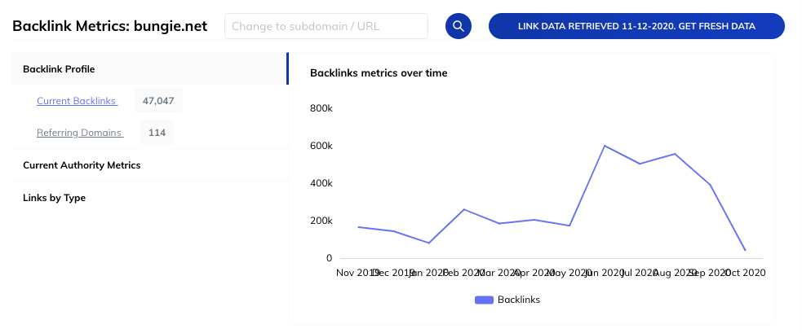
Backlink Metrics
Source: Raven by TapClick

Slide 15
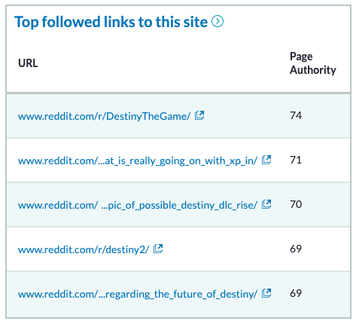
Social Media Backlinking
Source: MOZ Link Research

Slide 16
Website Content:
Desktop/Mobile Landing Pages
Web Store
Forum
Help Pages
Game Statistics
Player Social Profiles
Matchmaking
Comic Books
Player-Created Content (“Creations”)
Website

Slide 17
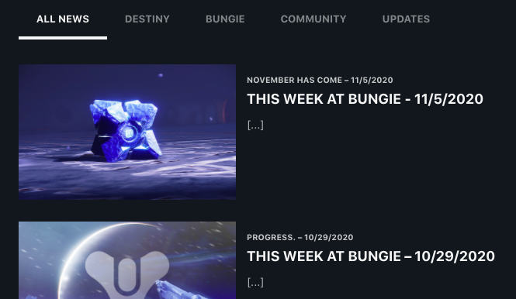
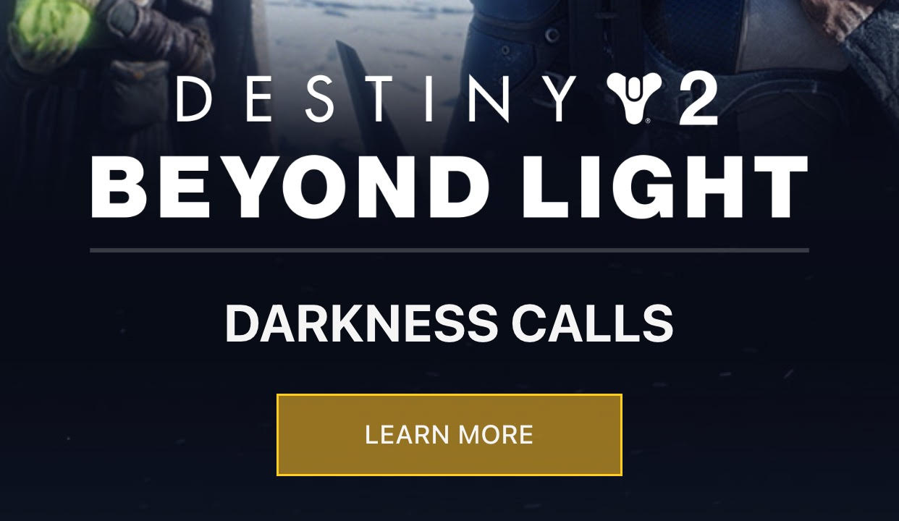
On Page SEO
Website Design
Limited Use of Strategic Keywords
Standard Keywords: Bungie, Myth, Beyond Light
Metatags: “Halo 3 Stats”
Java-based website
Limited editorial oversight

Slide 18
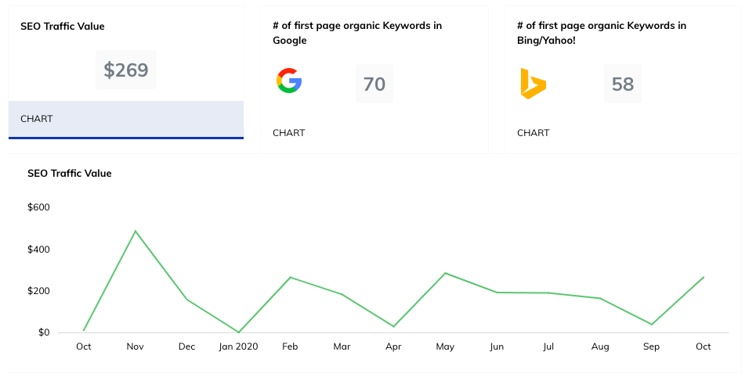
Keyword Overview
Source: Raven by TapClick

Slide 19
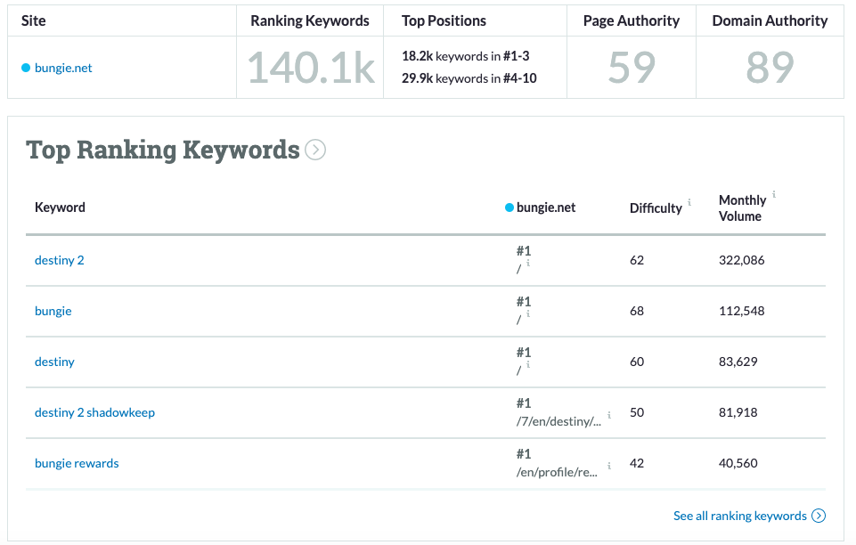
Top Ranking Keywords
Source: Raven by TapClick

Slide 20
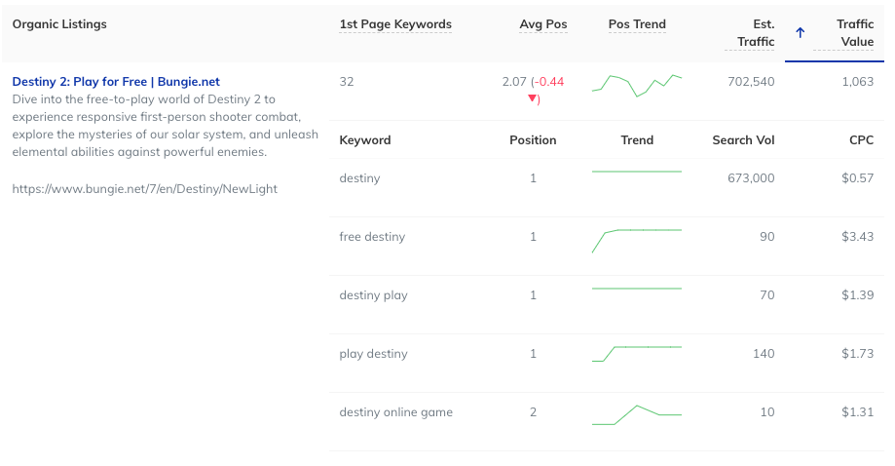
Top Organic Keywords - Bing
Source: Raven by TapClick

Slide 21
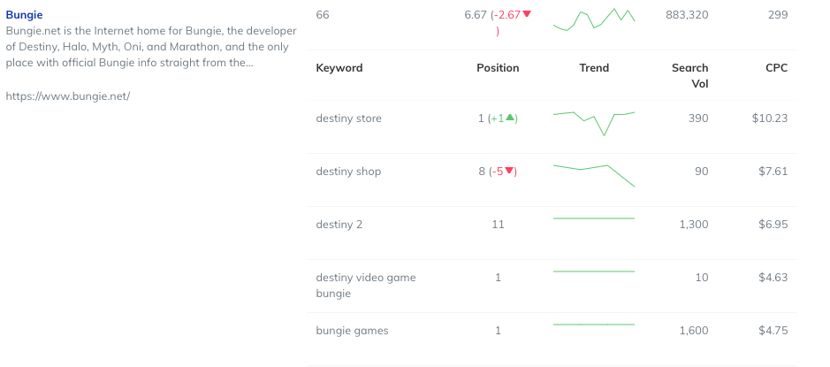
Top Organic Keywords - Google
Source: Raven by TapClick

Slide 22
Email:
Coordinated Email Campaign
Regular Promotional Blasts
Synchronized Email Blasts
Example: ViDoc Announcement
Newsletters:
Regular news (bungie.net/en/news)
This Week at Bungie (TWAB)
Weekly Newsletter
Published since 2004
Email
& Newsletters

Slide 23
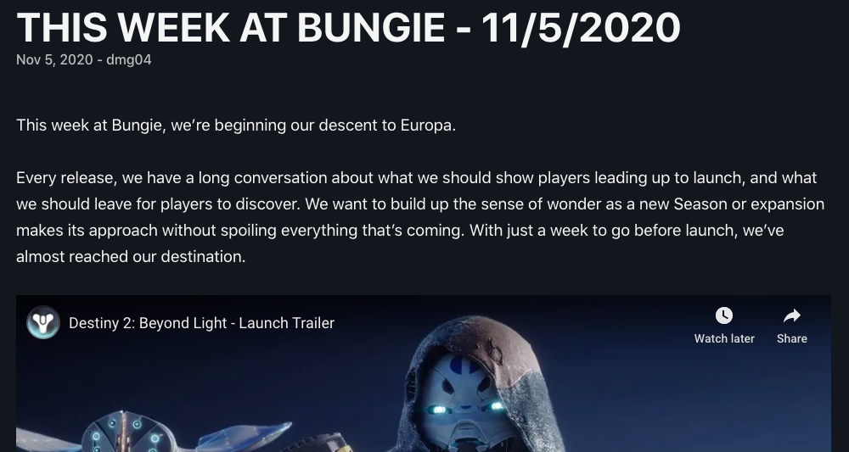
This Week at Bungie (TWAB)

Slide 24
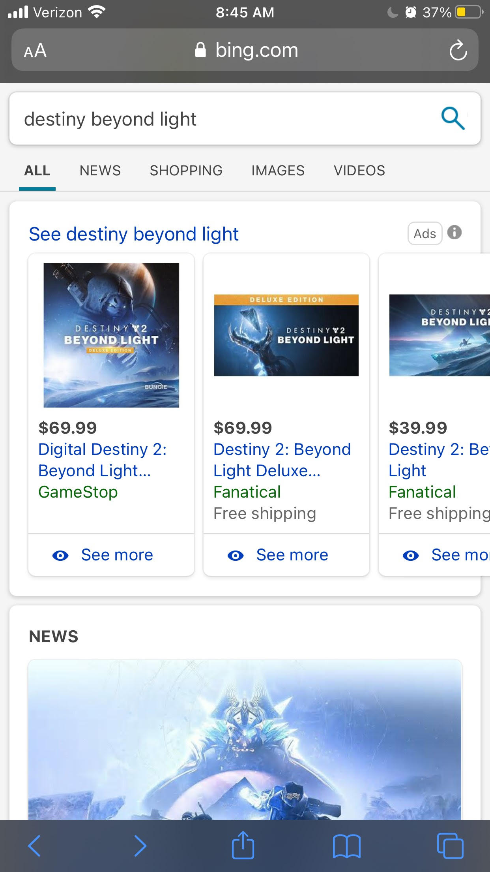
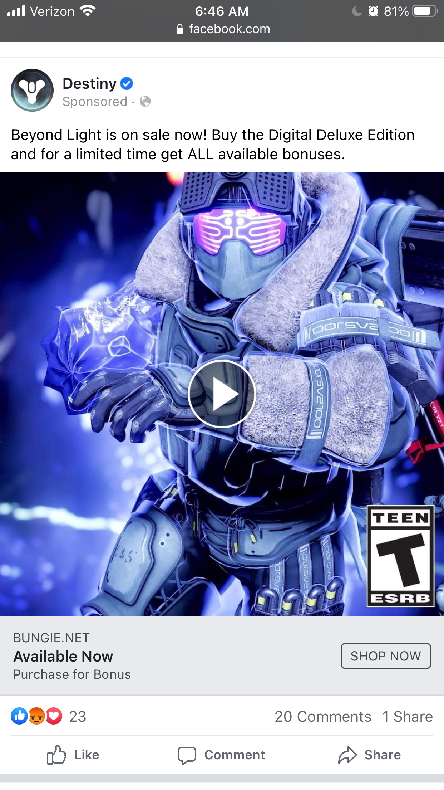

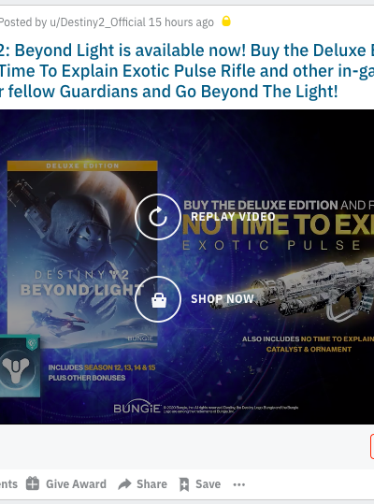
Advertising
Microsoft Advertising
Facebook
Amazon Advertising
Reddit

Slide 25
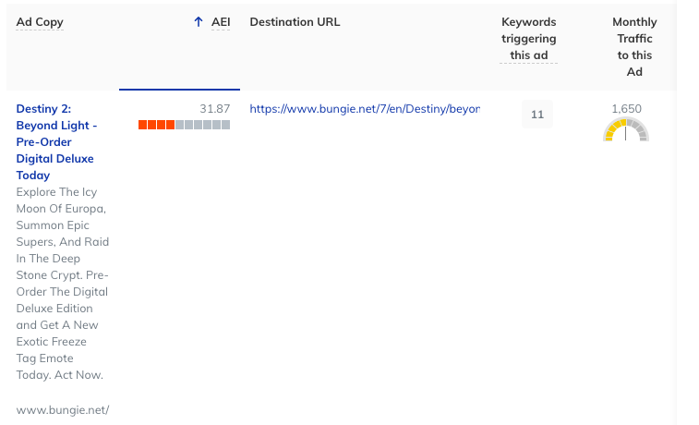
Paid Advertising
Source: Raven by TapClick

Slide 26
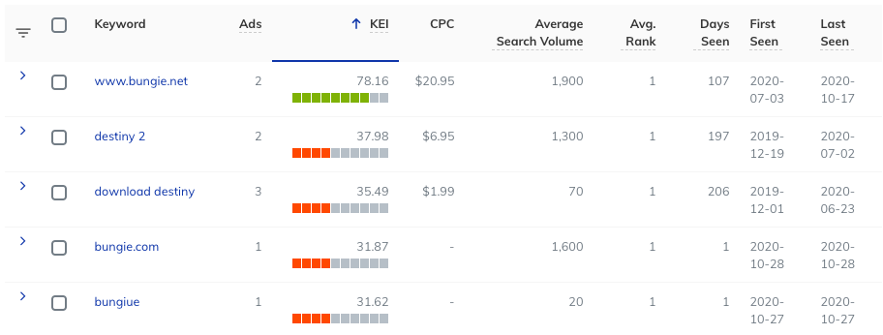
PPC
Source: Raven by TapClick

Slide 27
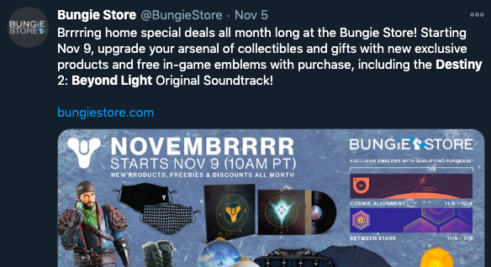
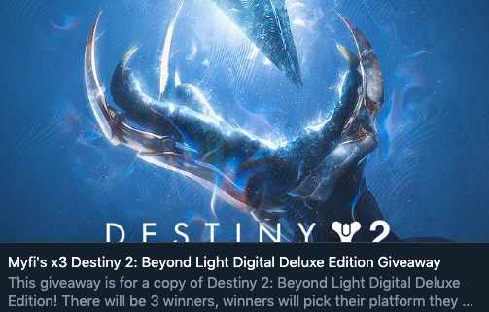
Promotions
Promotional Incentives
Promotional Pricing
Soundtrack Downloads
In-Game Rewards
Giveaways, Discount Codes
Content Creators, Websites

Slide 28
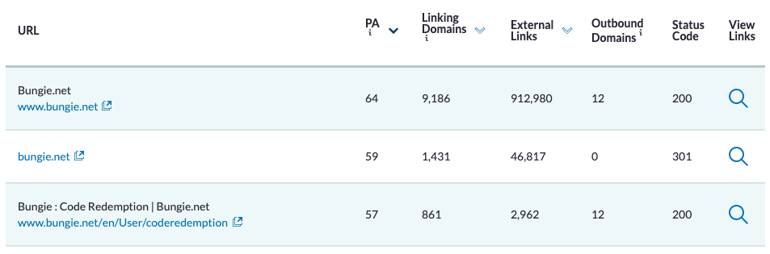
Promotional Metrics
Source: Raven by TapClick

Slide 29
06/09 - Reveal Livestream
06/09 - Gameplay Trailer
06/09 - Official Trailer
06/09 – Destiny 2 Trailer
08/27 – Game Mechanics Trailer
09/22 - Environmental Trailer
10/20 - Story Trailer
10/27 - ViDoc
10/29 - Launch Trailer
Video
Campaign

